Slide 1
Crypto From Zero
Cyber Skills Level Up

Slide 2
This sharing
Evolution of Cryptography
Cryptanalysis old cryptography
Understanding the insights of modern crypto
We will not go deep into the mechanism of modern scheme like AES

Slide 3
About Me
Tan Kel Zin
Discord @mechfrog88
Frequent Cryptography CTF Players
Graduated from NUS Computer Science and Math double major
Incoming Computer Science PhD student at NUS

Slide 4
Classical Cryptography

Slide 5




Why care?
Attack the enemies!
In Palace
Carry the Message
Awaiting Order 200km away from Place
Capture the messenger

Slide 6





Why care?
Let’s go Lunch together!
Write Down
Help Deliver note during class

Slide 7
The Problem
Confidentiality
Making sure that the information cannot be understand by interceptors
When will we have interceptors?
Going through unsecure channel
Messenger delivering message
Friends passing message note
Internet Network
Radiowave, WiFi

Slide 8
Solution
What can we do?
Restrictions:
Computers are not invented yet
Efficient encryption and decryption (5 minutes)
Ensure confidentiality
English alphabets and space only

Slide 9
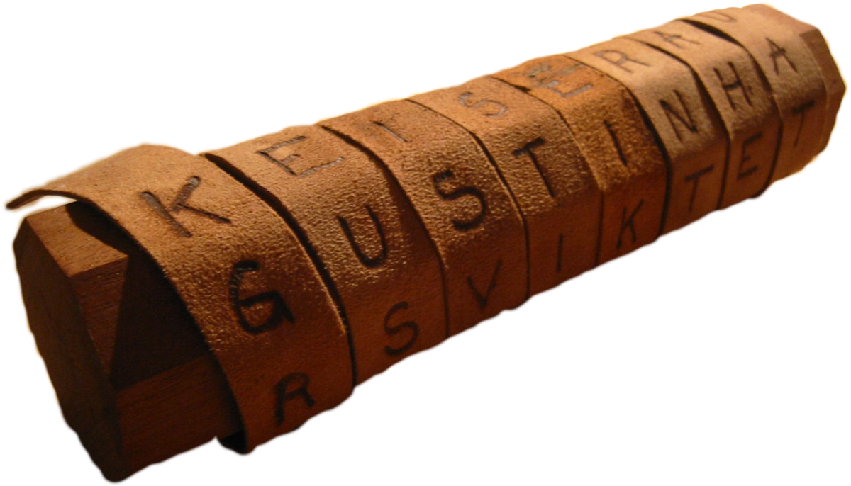
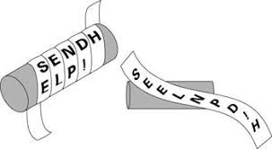
Attempt
Scytale
m: letsgo
c: lrgrbelbuqtmidasjxcwgnnfjonepm
Transposition Cipher
Lrgrbelbuqtmidasjxcwgnnfjonepm
Used by Spartans in ancient Greeks

Slide 10
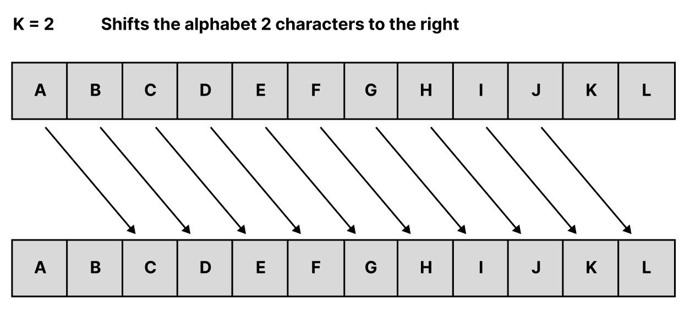
Attempt
m: helloworld
c: jgnnqyqtnf
Caesar Cipher

Slide 11
Discussion
What is the problem of Transposition Cipher and Caesar Cipher?
Security by obfuscation
Relies on the fact that others does not know the encryption and decryption protocol.
Once encryption protocol is learned, decryption is trivial

Slide 12
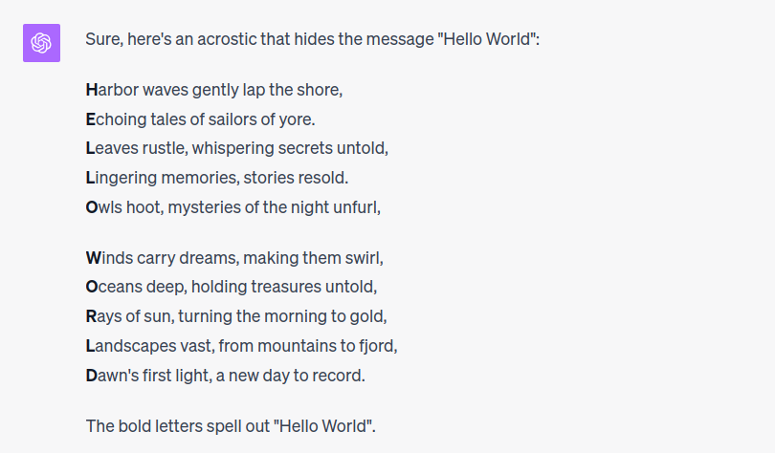
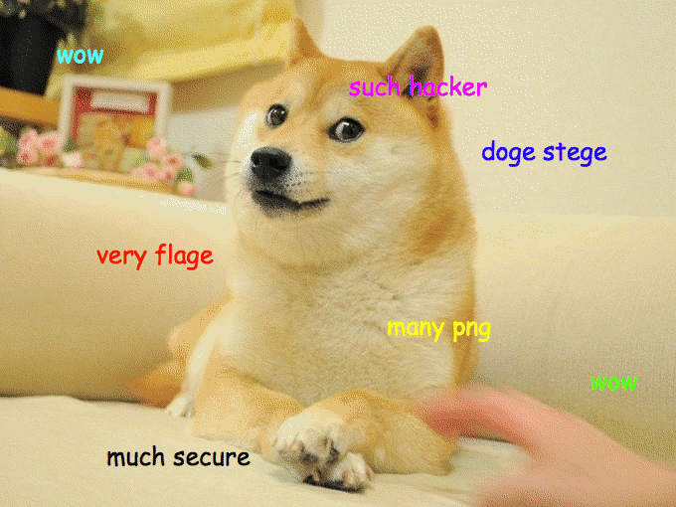
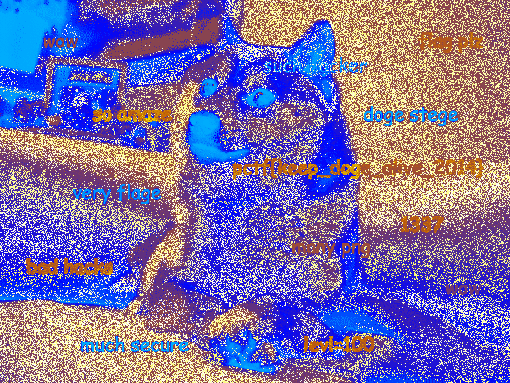


Steganography
Classic example of security by obfuscation
Hiding some message within another message
Text Based
Image Based
Audio Based
Text Example from https://daniellerch.me/
Image Example from plaidctf2014
Audio Example from wikipedia

Slide 13
Steganography
Is it useful in real life?
Yes, sometimes we don’t want to let others know that we are communicating something else
Spying
Watermarking Image & Audio
Sometimes also used in CTF questions
Fun to solve as a puzzle, not suitable for skill based competition
Notes:
Taken from https://daniellerch.me/

Slide 14
Security by obfuscation
Once decryption algorithm discovered, need change the scheme all together.
Inefficient and difficult to maintain the list of encryption algorithms.
Possibility of all past ciphertexts getting decrypted
Notes:
Taken from https://daniellerch.me/

Slide 15
New Requirement
Instead of hiding the algorithm, we introduce ‘key’ that acts as the hidden component.
Kerckhoff's Principle
A cryptosystem should be secure, even if everything about the system, except the key, is public knowledge.
Does the schemes that we introduced just now satisfies this property?
Notes:
Taken from https://daniellerch.me/

Slide 16
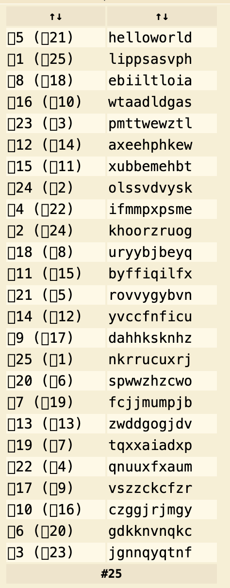
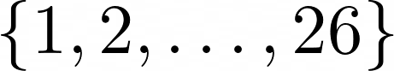
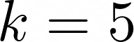
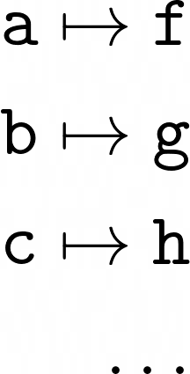

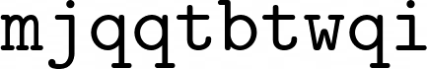
Attempt
Shift Cipher
Our key is one number from the set
Shift the alphabets by our key
Problems?

Slide 17
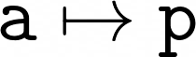

Attempt
Substitution Cipher
Pick a random permutation of alphabets
Substitute the alphabets according to the permuted alphabets

Slide 18
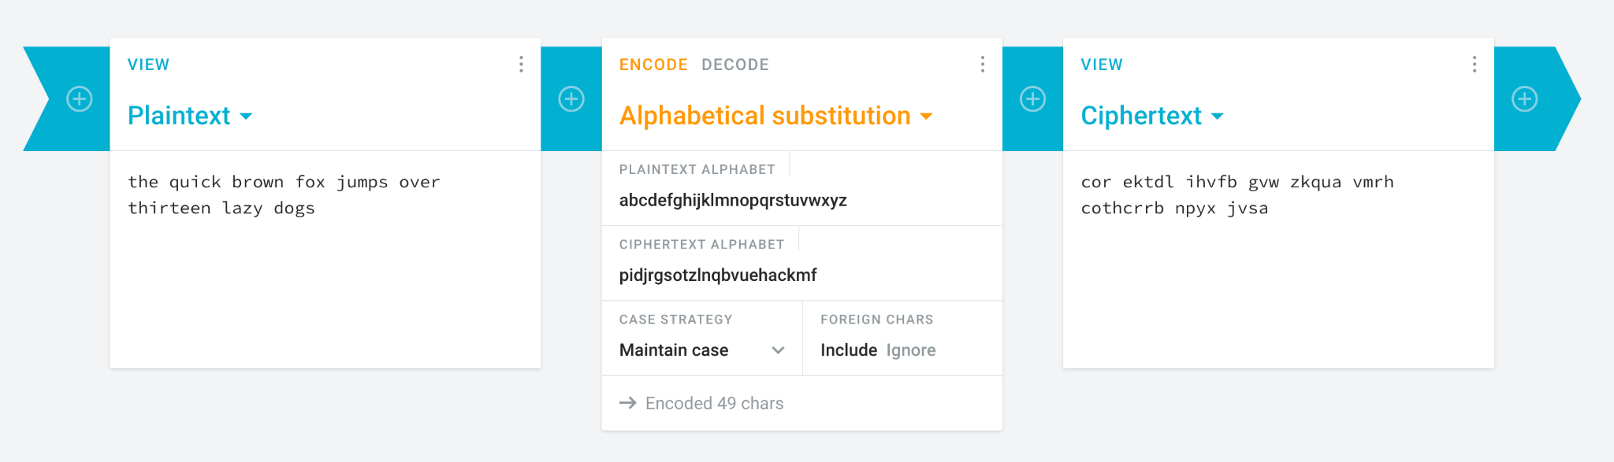
Substitution Cipher
How many possible key (permutations) are there?

Slide 19
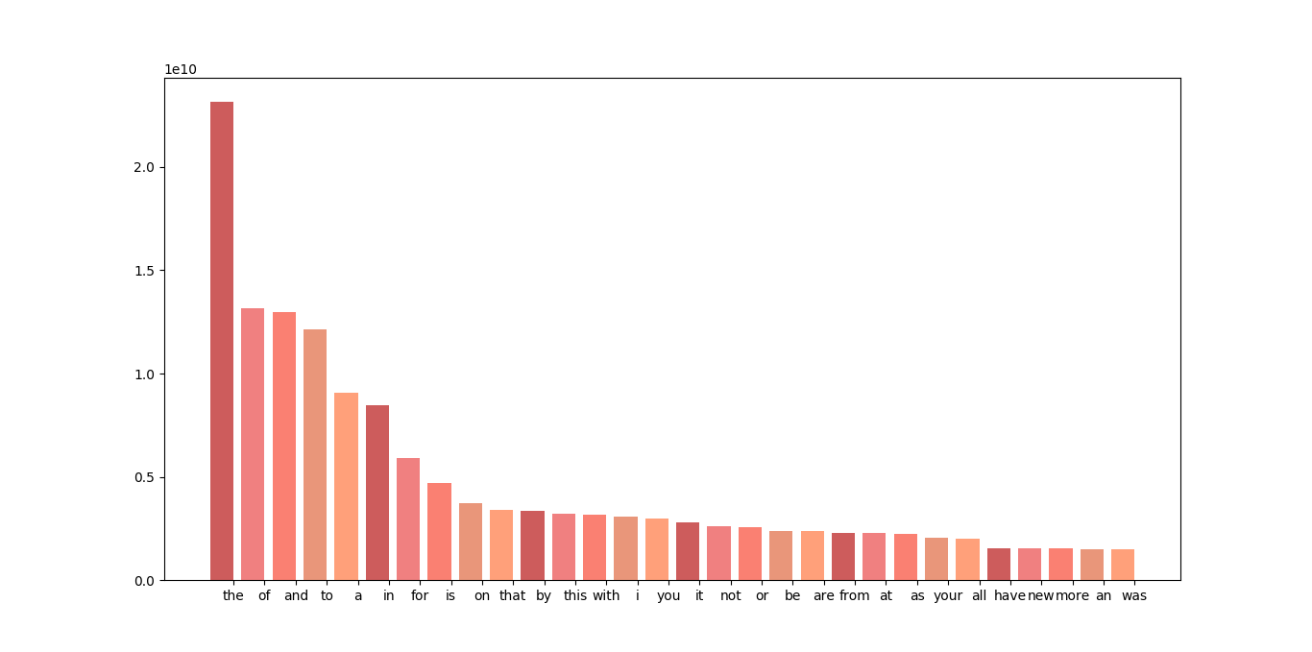
Substitution Cipher
Simple and efficient with large keyspace
Any problems?
Frequency of words
Is not changed
For a three letter word
It is very likely to be ‘the’

Slide 20
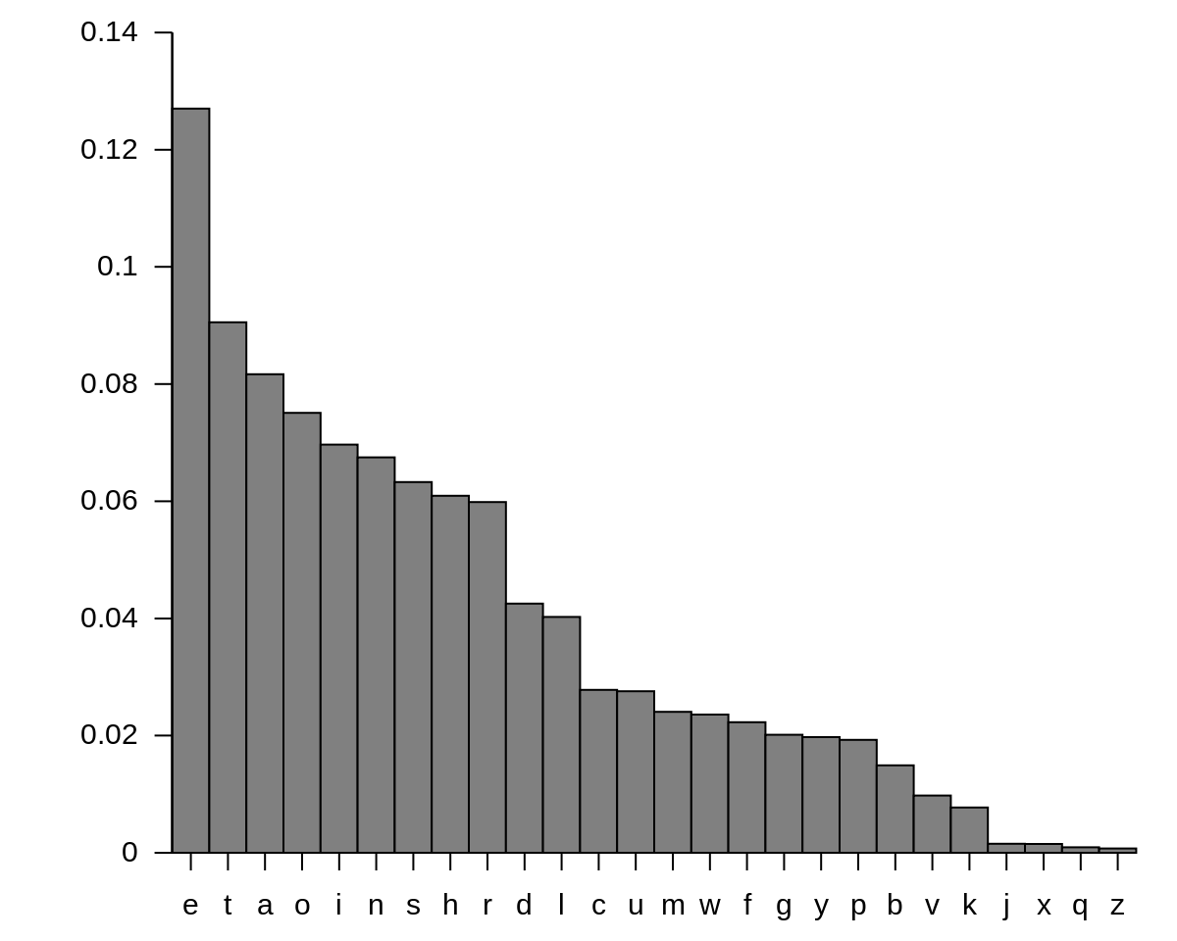
Substitution Cipher
Frequency of Letter
‘e’ is the most common letter in english.
We can predict which letter substitutes ‘e’ by counting the frequency of letter in the ciphertext

Slide 21
Substitution Cipher
Demo
P Crhqa pbj Dvbjtctvba pshrrqrbc pdca pa p nrspn dvbchpdc ircfrrb xvk (cor dvqupbx) pbj cor karh. Tc'a forhr xvk qptbcptb xvkh htsoca cv rwdnkjr karha ghvq xvkh puu tb cor rmrbc copc corx pikar xvkh friatcr/puu, arc vkc cor hknra gvh katbs xvkh arhmtdr pbj bvcr vcorh tquvhcpbc jrcptna pbj jtadnptqrha.
Opmtbs p Crhqa pbj Dvbjtctvba pshrrqrbc ta dvqunrcrnx vuctvbpn. Bv npfa hrekthr xvk cv opmr vbr. Bvc rmrb cor akurh-achtdc pbj ftjr-hrpdotbs Srbrhpn Jpcp Uhvcrdctvb Hrsknpctvb (SJUH).
Xvkh Crhqa pbj Dvbjtctvba pshrrqrbc ftnn ir kbtekrnx xvkha. Fotnr avqr dnpkara phr acpbjphj pbj dvqqvbnx arrb tb uhrccx qkdo rmrhx Crhqa pbj Dvbjtctvba pshrrqrbc, tc'a ku cv xvk cv arc cor hknra pbj sktjrntbra copc cor karh qkac pshrr cv.
Crhqa pbj Dvbjtctvba pshrrqrbca phr pnav lbvfb pa Crhqa vg Arhmtdr vh Crhqa vg Kar pshrrqrbca. Corar crhqa phr tbcrhdopbsrpinr, uhpdctdpnnx aurpltbs. Qvhr hphrnx, tc qpx ir dpnnrj avqrcotbs ntlr pb Rbj Karh Arhmtdra Pshrrqrbc (RKAP).

Slide 22
Substitution Cipher
All Language suffers from frequency analysis attack.
How to fix?
Problem arise because the same letter in the text gets substitute to the same cipher letter regardless of position
Simple Fix, we make substitution now also depending on the position of the letter in the text

Slide 23
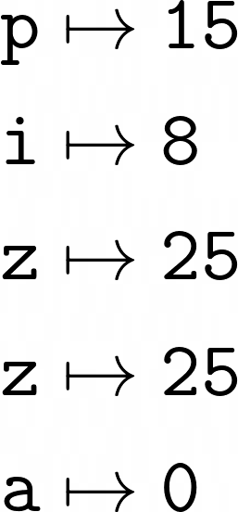
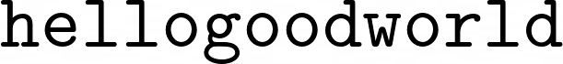
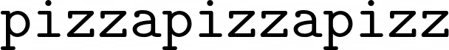
Vigenere Cipher (Polyalphabetic Substitution Cipher)
We choose any text as our key.
Suppose our key is pizza
pizza convert to alphabet order is
Encrypt
Repeat pad key until same length
According to the padded key, shift the message letter by the key’s alphabet order

Slide 24
Polyalphabetic Substitution Cipher
Frequency Analysis?
Suppose our key is pizza
Same letter, different position, can map to different letter
Any Problems?

Slide 25
Polyalphabetic Substitution Cipher
Key is repeated, if our key length is 5, the mapping will repeat after 5 letters
Suppose our key is pizza
First letter of each group has the same mapping
Once we guessed the key length, we can do frequency analysis by only relating the letters where their distance is multiples of the key length

Slide 26
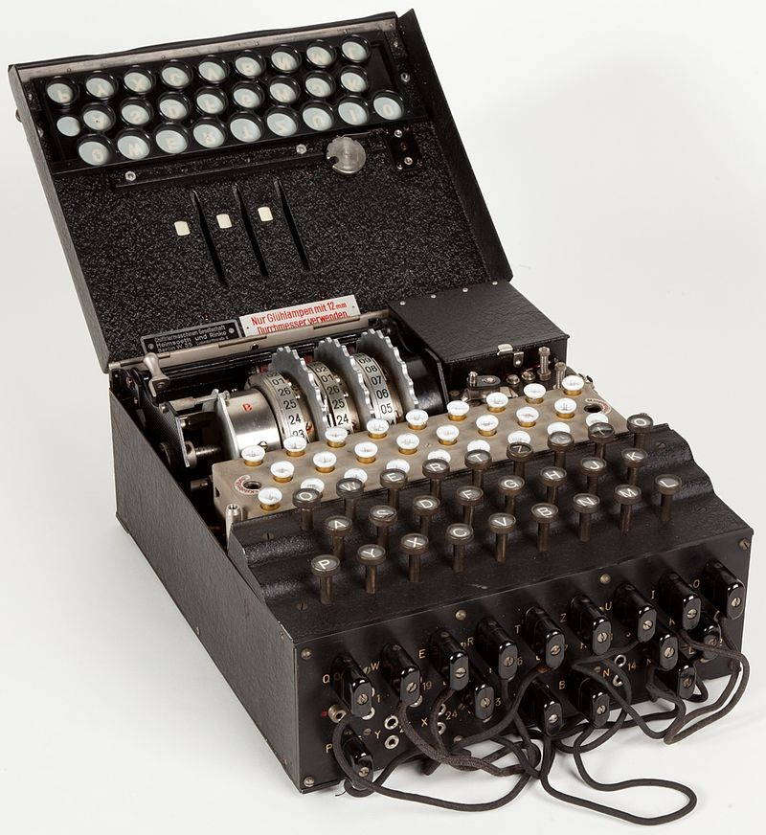
Polyalphabetic Substitution Cipher
Make it more complicated
Enigma Machine
Used in War World II
But still broken in the end

Slide 27


Cat and Mouse
Find New Attack
Patch against Attack
Adversary
Scheme Designer
Can we ever have scheme that is perfectly secure?

Slide 28
Modern Cryptography

Slide 29



How do we start?
We have to rigorously define cryptography
Unsecure Channel
Listening to chanel, able to capture all message
Alice
Bob
Message m
Adversary

Slide 30
Scheme
Define our Encryption Scheme as a Tuple of 3 functions
(KeyGen, Enc, Dec)
KeyGen() - Return a key from keyspace
Enc(k, m) - Takes in key k and message m, return ciphertext c
Dec(k, c) - Takes in key k and ciphertext c, return message m
Keyspace K, Message Space M, Ciphertext Space C
Assume the spaces are finite

Slide 31
Required Properties
Correctness
For all keys k, message m
Dec(k, Enc(k, m)) = m
Security
How?

Slide 32
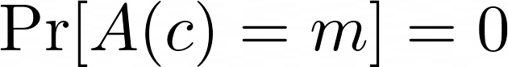
Security
Definition 1
No algorithm can retrieve m without the knowledge of k
For all algorithm A, the probability of A return the correct m given c is 0
Problems?

Slide 33
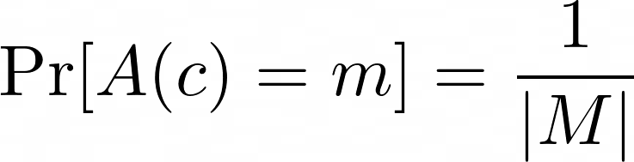
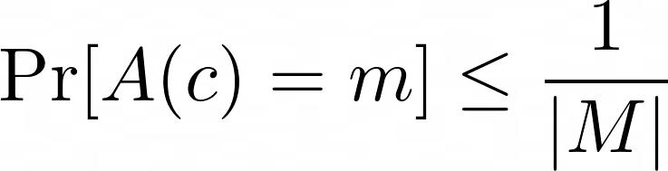
Security
Suppose there is an algorithm that just randomly guess the message m
Security
For all algorithm A, the probability of A return the correct m given c is not better than random guessing

Slide 34
Security
How to construct a scheme that satisfies these requirements?
XOR Operation
a | b | a xor b
0 | 0 | 0
0 | 1 | 1
1 | 0 | 1
1 | 1 | 0
Suppose a is the message, b is the key, we randomly set b as 0 or 1
Given a xor b, we can never tell the original value of a
Let’s make our encryption the xor operation

Slide 35
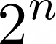
One Time Pad
Suppose the spaces are the n bits numbers
The size will then be |K| = |M| = |C| =
KeyGen() -> a randomly sample n bit element k
Enc(k, m) -> k xor m
Dec(k, c) -> k xor c
Correctness
Dec(k, Enc(k, m)) = Dec(k, k xor m) = k xor (k xor m) = m

Slide 36
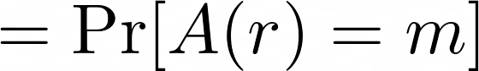
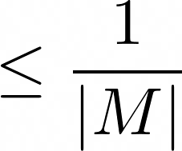
One Time Pad
KeyGen() -> a randomly sample n bit element k
Enc(k, m) -> k xor m
Dec(k, c) -> k xor c
Security
Want to show that
No information about m, so m xor k looks just like a random value r
Can’t do any better than random guessing

Slide 37
Alternative Definition of Security
Security
For all pair of message m1, m2 their ciphertexts looks the same

Slide 38
One Time Pad
We just show that One Time Pad is perfectly secure
Why not we just use One Time Pad for all encryption scheme?
Problems
We cannot reuse the key, our security model only allows one time usage
Key Space same size as Message Space. To send 1GB data we need 1GB key

Slide 39
Weakening One Time Pad
We don’t need perfect secrecy, all existing computer cannot decrypt it is enough
Computational Security (Rough Definition)
For all efficient (probabilistic polynomial time) algorithm A, the probability of A returning the correct message m given only c is negligible
Modern practical schemes, AES, CHACHA20, RSA, DHKE all relies on computation security

Slide 40
Improving our model
Not able to reuse key is not ideal, we have to modify our security model to allow it.
CPA Security Game
Instead of asking the adversary to return the decrypted message, we now allow adversary to query for ciphertext with chosen message.
At the end of the game, the adversary has to output the correct message

Slide 41
How to construct computationally secure OTP?
Let’s assume we have a magical function Psuedorandom Generator (PRG)
Properties
This function takes in a small random string to generate long random string that looks indistinguishable from a normal random string
With PRG, we can then reduce our keysize by a significant amount!

Slide 42
Discussion
We requires that new schemes must be rigorously proven secure, either computationally secure or perfectly secure
So why are there still attacks?

Slide 43
Important Primitives
One Way Function
A one way function F, is a function that can be efficiently compute, and where given F(x), it is hard to find x’ such that F(x’) = F(x)
Efficient meant that it can be run in polynomial time, hard meant that no algorithm can find inverse within polynomial time
A PRG must be a one way function
With a one way function, we can construct a PRG

Slide 44
One Way Function
Any examples for one way function?
We have not yet found a single one way function.
If found then means we proved P != NP

Slide 45
Assumptions
Most of the schemes are only be proven secure under the assumptions of OWF
If the construction based on some assumed OWF that is incorrect, the whole scheme will fail

Slide 46
The schemes that we are using now
AES
Designed to be a Psuedorandom Function (PRF), a stronger PRG
Diffie-Hellman Key Exchange
Security relies on the Discrete Logarithm Assumption
RSA
Security relies on the RSA Assumption (believed to be as hard as Integer Factorisation Problem)

Slide 47
Final Words
Some of these assumptions might not be true anymore when quantum era arrives
We have to find more candidates to diversify cryptography
Many more primitives, Collision Resistance Hash Function, Digital Signature, Key Exchange, Trapdoor Function, Zero Knowledge Proof…

Slide 48
Cryptography in CTF
Incorrect Implementation of a scheme, find weakness
Author designed a new scheme on their own, cryptanalysis it
Provided more leaks or more information than usual implementation
New attacks on underlying assumptions
To get better cryptography CTF, try solving challenges at
https://cryptohack.org

Slide 49
Thank you for listening

